Slide 1
Building Android apps – Week 6
2843-201710_MCS4993_M:Topics in MA/CS
2843-201710_MCS5993_M:Topics in Computer Science
Notes:
Look at the

Slide 2
Agenda
Chapter 9 HFAD – Action Bars

Slide 3
Bullet Points
To add an action bar to apps supporting API level 11 or above apply one of the Holo or Material themes.
Add an action bar to apps supporting API level 7 or above by applying an AppCompat theme and using theActionBarActivity class. If you use ActionBarActivity, you must use an AppCompat theme.
ActionBarActivity and the AppCompat themes are in the v7 appcompat support library.
The android:theme attribute in AndroidManifest.xml specifies which theme to apply.
You define styles in a style resource file using the <style> element. The name attribute gives the style a name. The parent attribute specifies where the style should inherit its properties from.
The default folder for style resource files is app/src/main/res/values. Put a style resource file in theapp/src/main/res/values-v21 folder if you want it to be used on API level 21.
Add action items to your action bar by adding items to a menu resource file.

Slide 4
Bullet Points
Add the items in the menu resource file to the action bar by implementing the activity’sonCreateOptionsMenu() method.
Say what items should do when clicked by implementing the activity’s onOptionsItemSelected()method.
You can share content by adding the share action provider to your action bar. Add it by including it in your menu resource file. Call its setShareIntent() method to pass it an intent describing the content you wish to share.
Add an Up button to your action bar to navigate up the app’s hierarchy. Specify the hierarchy inAndroidManifest.xml. Use the ActionBar setDisplayHomeAsUpEnabled() method to enable the Up button.

Slide 5
Notes:
Great apps have a clear structure
Back in Chapter 6, we looked at ways of structuring an app to create the best user experience. Remember that when you create an app, you will have three different types of screen:
TOP-LEVEL SCREENS
This is usually the first activity in your app that your user sees.
CATEGORY SCREENS
Category screens show the data that belongs to a particular category, often in a list. They allow the user to navigate to detail/edit screens.
DETAIL/EDIT SCREENS
These display details for a particular record, let the user edit the record, or allow the user to enter new records.

Slide 6
Notes:
THEY ALSO HAVE GREAT SHORTCUTS
If a user’s going to use your app a lot, they’ll want quick ways to get around. We’re going to look at navigational views that will give your user shortcuts around your app, providing more space in your app for actual content. Let’s begin by taking a closer look at the top-level screen in the above Pizza app.
In the top-level screen of the Pizza app, there’s a list of options for places in the app the user can go to.

Slide 7
Notes:
In Android apps, active navigational options are usually added to the action bar. The action bar is the bar you often see at the top of activities. It’s the place where common actions are displayed, so it normally includes buttons that are best described using verbs such as Create, Search, or Edit.
In the Pizza app, we can make it easy for the user to place an order wherever they are in the app by adding an action bar to the top of every activity. The action bar will include a Create Order button so the user has access to it wherever they are.
Let’s start with the action bar
The action bar has a number of uses:
For displaying the app or activity name so that the user knows where in the app they are. As an example, an email app might use it to indicate whether the user is in her inbox or junk folder.
For making key actions prominent in a way that’s predictable—for example, sharing content or performing searches.
For navigating to other activities to perform an action.
To add an action bar, you need to use a theme that includes an action bar. A theme is a style that’s applied to an entire activity or application so that your app has a consistent look and feel. It controls such things as the color of the activity background and action bar, and the style of the text. Android has a number of built-in themes you can use.

Slide 8
Notes:
If you want your apps to run on API level 11 or above, you add an action bar by applying Theme.Holo or one of its subclasses. This is what you’ll need to do most of the time. For API level 21 or above, you have the added option of using one of the newer Theme.Material themes. There are several different themes to choose from depending on what appearance you want your app to have. As an example, applying a theme of Theme.Material.Light.DarkActionBar will give you activities with a light background and a dark action bar.
If you need to support older devices running API level 7 or above, you can still add an action bar but you need to do it slightly differently. You first need to change your activities so that they extend the class android.support.v7.app.ActionBarActivity instead of the android.app.Activity class. You must then apply one of the Theme.AppCompat themes.

Slide 9
Notes:
As time passes, Android continued to add new features. But what if you want to use the latest Android widgets on a device that’s two or three years old? The Android support libraries are a set of code libraries that you can include in your project. They’re primarily there for backward compatibility, as they allow you to use newer features of Android in older devices.Some features of Android are only available in the support libraries, so if you need to use these features in your app, you need to use the support library. As an example, the DrawerLayout APIs allow you to create a navigation drawer you can pull out from the side of the screen, and these APIs are currently only available in the v4 support library.The Android support library package includes several support libraries. Each one targets a base API level and includes a specific set of features. The name of the support library reflects the lowest version number of Android the library is compatible with. The v4 support library, for instance, can be used with API level 4 and higher. Similarly, the v7 support libraries can be used with API level 7 and higher. Each of these libraries undergo revisions to include new features and bug fixes.The classes in a support library are stored within packages named android.support.v*. As an example, the v4 library has classes in the android.support.v4 package.

Slide 10

Notes:
Go to https://developer.android.com/topic/libraries/support-library/features.html
Support libraries are put in the dependencies which are in the build.gradle file

Slide 11
Notes:
We’re going to build a prototype of the Pizza app that supports API level 17 and above. Create a new Android project with a blank activity for an application named “Bits and Pizzas” with a package name of com.hfad.bitsandpizzas. The minimum SDK should be API level 17. Specify an activity called “MainActivity”, a layout called “activity_main” and a menu resource called “menu_main”.We’re going to look at how your new project may be using support libraries by default. First, let’s look at MainActivity.java. Here’s the code that Android Studio created for us. By default, MainActivity extends the android.support.v7.app.ActionBarActivity class. In other words, it’s using a v7 support library:
The ActionBarActivity class is used in conjunction with the Theme.AppCompat themes to add action bars to apps that support API levels between 7 and 10. If you use the ActionBarActivity class as the superclass for your activities, you have to use one of these themes or your app won’t run. You can’t use more recent themes, such as Material.

Slide 12
Notes:
Even if you remove references to ActionBarActivity from your app, the v7 support library may still be a dependency in your project. You can see this by going to File→Project Structure. When you click on the app module and choose Dependencies, you may find there’s a reference to the v7 appcompat library:

Slide 13
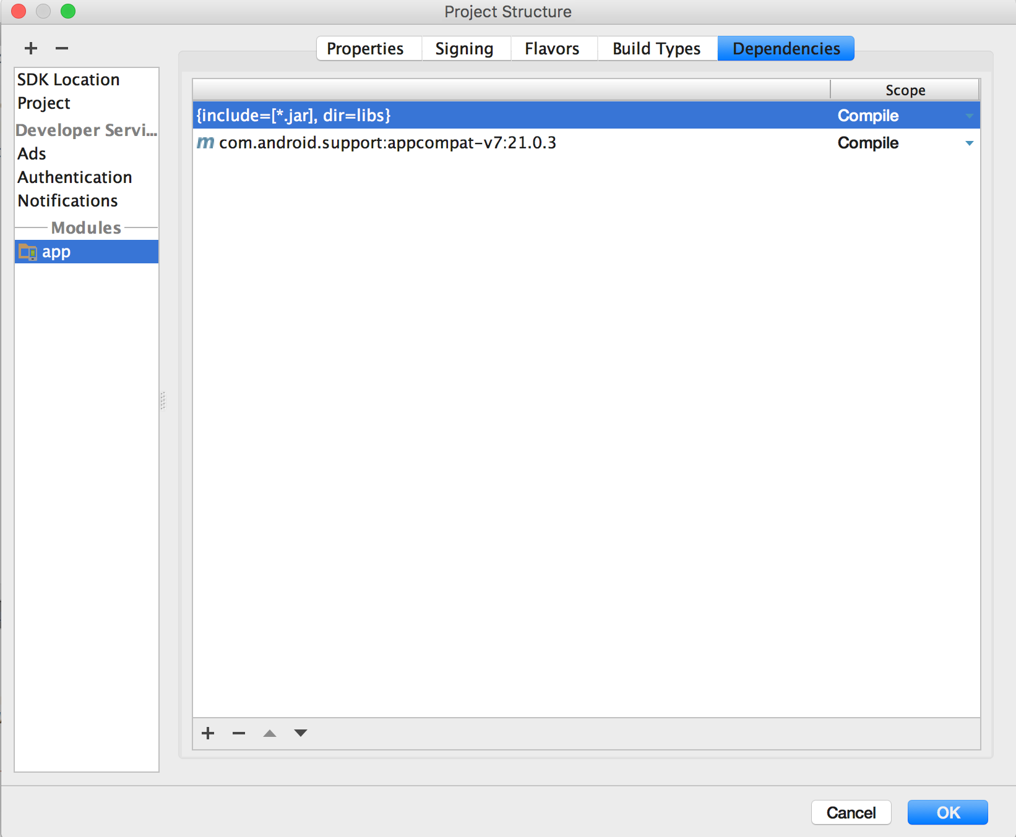
Notes:
This is what it looks like in Android Studio 2.2, walk through what else is in there.

Slide 14
Notes:
We’ll get the app to use up to date themes
We want our prototype app to include action bars. The app supports devices running a minimum of API level 17, so we don’t need to provide backward compatibility by using ActionBarActivityand Theme.AppCompat. Instead, we’ll bring the look more up to date by using a Holo theme by default, and get it to switch to a Material theme if it’s running on API level 21.
To do this, we need to do two things:
Make sure the activity code doesn’t reference ActionBarActivity.
If it does, we’ll only be able to use a Theme.AppCompat theme.
Apply the themes.
We’ll get the app to pick up the right theme for the API level it’s running on.
We’re going to keep the dependency on the v7 appcompat library as this has an impact on the code you’ll write later on.
We’ll start by making sure that MainActivity.java uses the Activity class and not ActionBarActivity. Update your code so that it looks like the code below:

Slide 15
Notes:
As you’ve already seen, the app’s AndroidManifest.xml file provides essential information about the app such as what activities it contains. It also includes a number of attributes that have an impact on your action bars.
The android:icon attribute is used to assign an icon to the app. The icon is used as the launcher icon for the app, and if the theme you’re using displays an icon in the action bar, it will use this icon.
The icon can be a drawable or mipmap resource. A mipmap is an image that can be used for application icons, and they’re held in mipmap* folders in app/src/main/res. Just as with drawables, you can add different images for different screen densities by adding them to an appropriately namedmipmap folder. As an example, an icon in the mipmap-hdpi folder will be used by devices with high-density screens. You refer to mipmap resources in your layout using @mipmap
The android:label attribute assigns a user-friendly label to the app or activity, depending on whether it’s used in the <application> or <activity> attribute. The action bar displays the current activity’s label. If the current activity has no label, it uses the app’s label instead.
The android:theme attribute specifies the theme. Using this attribute in the <application>element applies it to the entire app. Using it in the <activity> element applies it to a single activity.
Our android:theme attribute has the value "@style/AppTheme". The @style prefix means that the theme is defined in a style resource file. So what’s a style resource file?

Slide 16
Notes:
A style resource file holds details of any themes you want to use.
When you create a project in Android Studio, the IDE creates a default style resource file for you called styles.xml located in the app/src/main/res/values folder. It will look something like this:
The style resource file contains one or more styles. Each style is defined using the <style> element.
Each style must have a name, which you define with the name attribute. The style must have a name so that the android:theme attribute in AndroidManifest.xml can refer to it. In our case, the style has a name of "AppTheme", so AndroidManifest.xml can refer to is using "@style/AppTheme".

Slide 17
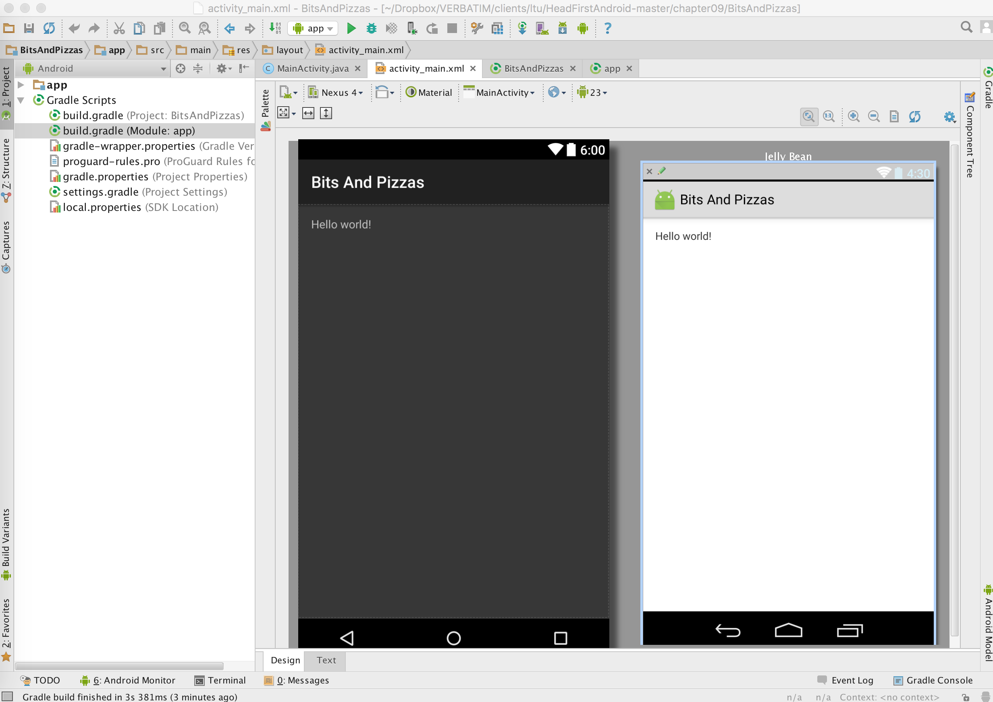
Notes:
Show the different APIS, then click on theme i.e. Material as well as API etc.

Slide 18
Notes:
The parent attribute specifies where the style should inherit its properties from. In the case above, this is "Theme.AppCompat.Light.DarkActionBar".
You can also use the style resource file to customize the look of your app by modifying the properties of an existing theme. To do this, you add an <item> element to the <style> that describes the modification you want to make. As an example, here’s how you’d modify the theme so that all the activities have a red background:

Slide 19
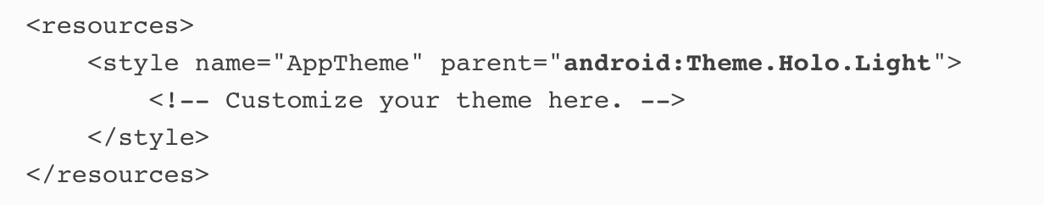
Notes:
We’re going to change the app so that it uses Theme.Holo.Light by default, and switches to usingTheme.Material.Light if the app’s running on API level 21.
We’ll start by changing the default theme. To do this, open the style resource file styles.xml located in theapp/src/main/res/values folder. This is the default style resource file. By default, we want to use a theme ofTheme.Holo.Light, so this needs to be reflected in the <style> attribute like this:

Slide 20
Notes:
When you run the app, MainActivity has an action bar. If you run the app on a device that has API level 21, the app uses a theme of Theme.Material.Light. If you run the app on a device with a lower API level, it uses a theme of Theme.Holo.Light.

Slide 21
Notes:
you can use different folder structures to get your app to use different resources at runtime. As an example, you saw how to get your app to use different layout files depending on the size of the device screen.
Here, we need the app to use a different style resource depending on the API level the app’s running on. To get the app to use a particular resource if the app’s running on API level 21, we can create a new values-v21 resource file and add the resource to this folder.
To do this, create a new folder in the app/src/main/res folder called values-v21. Then copy the file styles.xml from the values folder, and paste it in the values-v21 folder.

Slide 22
Notes:
We want the app to use a Material theme if it’s running on API level 21, so edit styles.xml in the values-v21 folder so that it uses a theme of Theme.Material.Light:
The style name we’re using in each style resource file should be the same, because this enables an appropriate theme to be used at runtime. Let’s see how.

Slide 23
Notes:
What happens when you run the app
1. When you run the app, Android sees that it needs to apply the theme described by @style/AppTheme.
2. If the app’s running on API level 21, it uses the style called AppTheme in the values-21 folder.
The style specifies a theme of Theme.Material.Light, so it applies this theme.
3. If the app’s running on an API level below 21, it uses the style called AppTheme in the values folder.
The style specifies a theme of Theme.Holo.Light, so this theme is applied instead.

Slide 24
Notes:
Adding action items to the action bar
Most of the time, you’ll want to add action items to the action bar. These are buttons or text in the action bar you can click on to make something happen. As an example, we’re going to add a “Create Order” button to our action bar.

Slide 25
Adding action items to action bar
Define the action items in a menu resource file.
Get the activity to inflate the menu resource.
You do this by implementing the onCreateOptionsMenu() method.
Add code to say what each item should do when clicked.
You do this by implementing the onOptionsItemSelected() method.

Slide 26
Notes:
When you create a project containing an activity, Android Studio creates a default menu resource file for you. We told Android Studio to call this file menu_main.xml, and it created it in the app/src/main/res/menu folder. All menu resource files go in this folder.

Slide 27
Notes:
Here’s the menu resource file Android Studio created for us. It describes a single Settings action item that appears in the action bar overflow: Each menu resource file has a <menu> element at its root. A menu resource file defines a single menu, or set of items to be added to the action bar. Your app can contain multiple resource files, and this is useful if you want different activities to have different items on their action bars.

Slide 28
showAsAction | Description
"ifRoom" | Place the item in the action bar if there’s space. If there’s not space, put it in the overflow.
"withText" | Include the item’s title text.
"never" | Put the item in the overflow area, and never in the main action bar.
"always" | Always place the item in the main area of the action bar. This value should be used sparingly; if you apply this to many items, they may overlap each other.
Notes:
The showAsAction attribute is used to say how you want the item to appear in the action bar. As an example, you can use it to get an item to appear in the overflow rather than the main action bar, or to place an item on the main action bar only if there’s room. The attribute can take the following values:

Slide 29
<item> | Description
android:id | Gives the item a unique ID. You need this in order to refer to the item in your activity code.
android:icon | The item’s icon. This is a drawable or mipmap resource.
android:title | The item’s text. This may not get displayed if your item has an icon if there’s not space in the action bar for both. If the item appears in the action bar’s overflow, only the text will be displayed.
android:orderInCategory | An integer value that helps Android decide the order in which items should appear in the action bar.
Notes:
Items are added to the menu using the <item> element. Each action item is described using a separate <item>. The <item> element has a number of attributes you can use, here are some of the most common ones:

Slide 30
Notes:
Let’s look again at the showAsAction attribute in the menu resource code. Notice how the showAsActionattribute is prefixed with app: not android: Earlier in the chapter, you saw how our project had a dependency on the v7 appcompat library. The v7 appcompat library doesn’t include showAsAction in the android namespace.
If your project has a dependency on the v7 appcompat library, showAsAction must be prefixed with app:, and the <menu> attribute must include an attribute of
xmlns:app="http://schemas.android.com/apk/res-auto"If your project has no dependency on the v7 appcompat library, showAsAction must be prefixed withandroid:, not app:. You can also omit the attribute
xmlns:app="http://schemas.android.com/apk/res-auto"from the <menu> element.

Slide 31
Notes:
Add a new action item
We’re going to add a new item to the action bar for creating orders. The item will have a title of “Create Order” and an icon.
When you use icons in your action bar, you can create your own or use icons from the Android action bar icon pack. The icon pack contains many standard icons you can use in your apps.

Slide 32
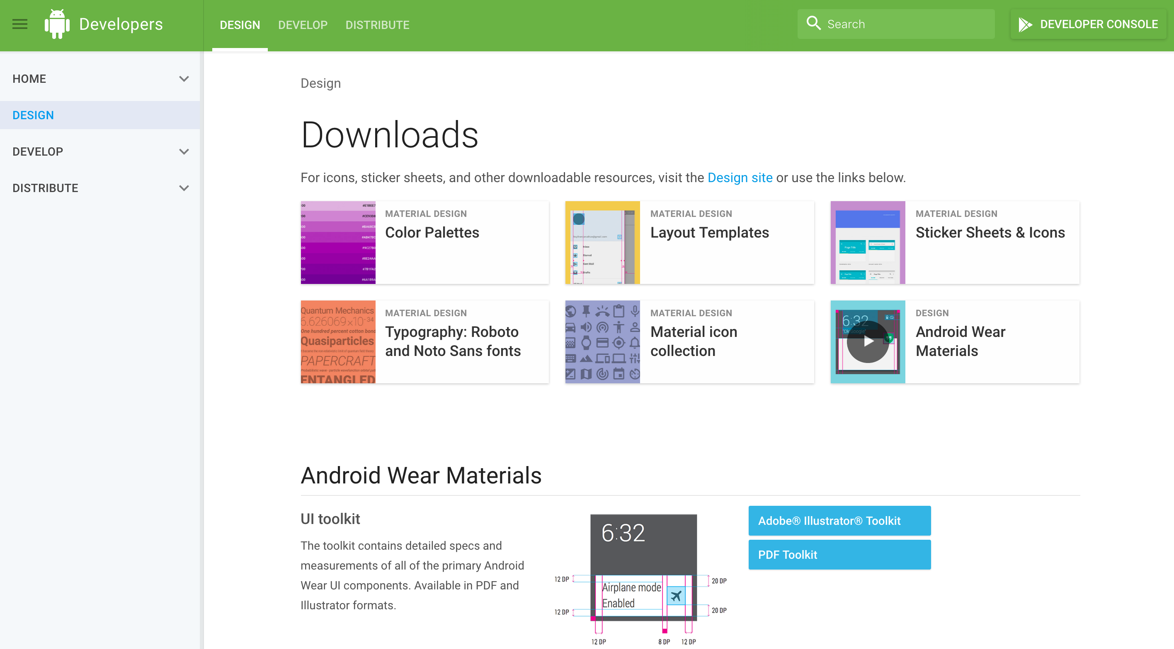
Notes:
We’re going to use the ic_action_new_event icon from the icon pack. First, download the icon pack from https://developer.android.com/design/downloads/index.html. If you expand it, you’ll see there are many different icons for different themes and screen sizes.The ic_action_new_event icons are located in the Action Bar Icons/holo_light/05_content_new_event folder. There are different icons for different screen sizes, indicated by their folder name.

Slide 33
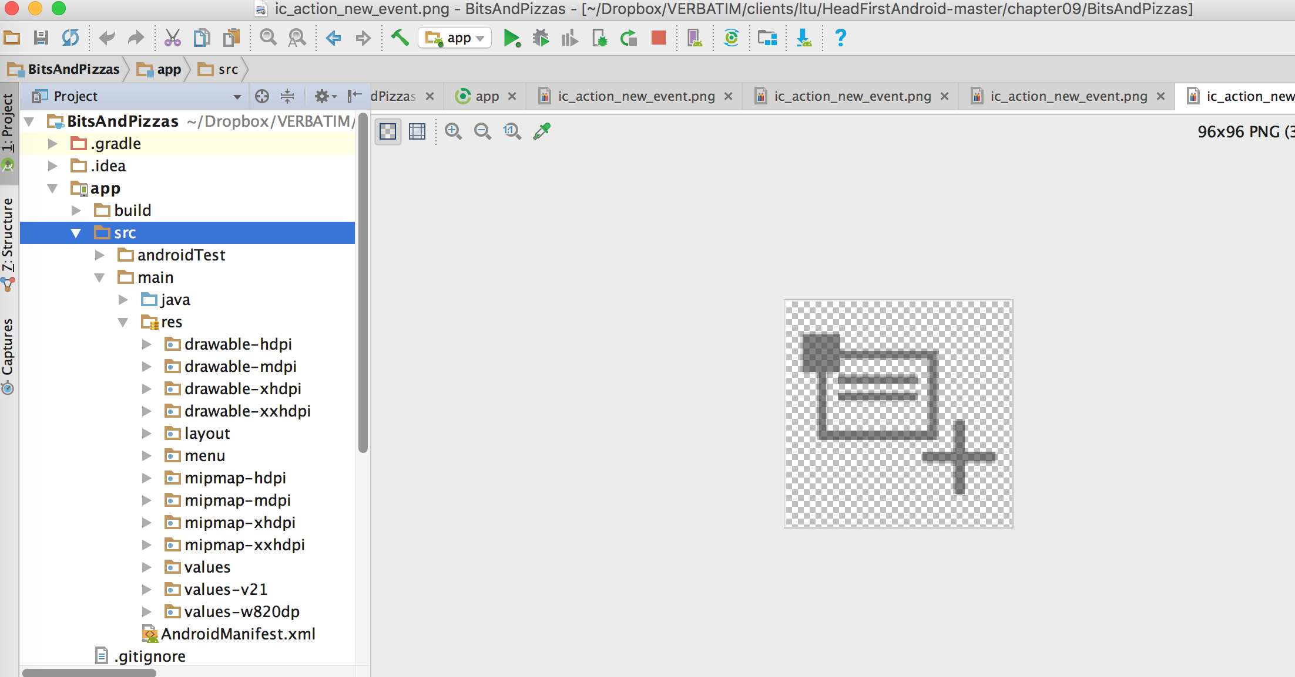
Notes:
You need to copy the icons to appropriate folders in your project. Copy the icon in the drawable-hdpi folder to the drawable_hdpi folder in your project, and so on.

Slide 34
Notes:
Once you’ve added the icons, add a new action_create_order string resource to strings.xml:

Slide 35
Notes:
Then add the menu item to menu_main.xml:
Now that you’ve added action items to the menu resource file, you need to add the items to your action bar in your activity code. Let’s see how.

Slide 36
Notes:
Inflate the menu in the activity with the onCreateOptionsMenu() method
Once you’ve created a menu resource file, you add the items it contains to the action bar by implementing the activity’s onCreateOptionsMenu() method. It runs when the action bar’s menu gets created and takes one parameter, a Menu object representing the action bar.

Slide 37
Notes:
You add items to the action bar using
This takes the menu items in the menu_main.xml menu resource file, and adds them to the action bar Menuobject.

Slide 38
Notes:
React to action item clicks with the onOptionsItemSelected() method
You get your activity to react to when an action item in the action bar is clicked by implementing theonOptionsItemSelected() method. This method runs whenever an item in the action bar is clicked.
The onOptionsItemSelected() method takes one attribute, a MenuItem object that represents the item on the action bar that was clicked. You can use the MenuItem’s getItemId() method to get the ID of the item on the action bar that was clicked so that you can perform an appropriate action, such as starting a new activity.
We’re going to get the Create Order action item to start a new activity called OrderActivity when it’s clicked.

Slide 39
Notes:
Create OrderActivity
We need to create a new activity called OrderActivity so our Create Order action item can launch it.
Start by creating a new blank activity. Give it a name of “OrderActivity”, a layout name of “activity_order”, a title of “Create Order”, and a menu resource name of “menu_order”.
Here’s the code for OrderActivity.java., make sure thatOrderActivity extends the Activity class and not ActionBarActivity. This is because you can only use one of the Theme.AppCompat themes with ActionBarActivity, and we want to use the Holo and Material themes .
We’ve not included the onCreateOptionsMenu() and onOptionsItemSelected() methods in ourOrderActivity code, as we don’t need OrderActivity to display menu items from the menu resource file in its action bar. These methods would need to be added if we ever did want to display menu items.
Now that we’ve created OrderActivity, let’s get the Create Order action item in MainActivity to start it.

Slide 40
Notes:
Start OrderActivity with the Create Order action item
We want to get the Create Order action item in the MainActivity action bar to start OrderActivity when it’s clicked. To do this, we need to update MainActivity’s onOptionsItemSelected() method. We’ll start OrderActivity using an intent.
When the Create Order action item is clicked, it will create an intent that starts OrderActivity.

Slide 41
Notes:
The full MainActivity.java code

Slide 42
Notes:
Test drive the app
When you run the app, a new Create Order action item is displayed in the MainActivity action bar. When you click on the action item, it starts OrderActivity.

Slide 43
Notes:
EXTRA CREDIT!!
Sharing content on the action bar
The next thing we’ll look at is how to use an action provider with your action bar. An action provider is an item you add to your action bar that handles its own appearance and behavior.
We’re going to concentrate on using the share action provider. The share action provider allows users to share content in your app with other apps such as Gmail. As an example, you could use it to let users send details of a particular pizza to one of their contacts.
The share action provider defines its own icon, so you don’t have to add it yourself. When you click on it, it provides you with a list of apps you can use to share content.

Slide 44
Notes:
YOU SHARE THE CONTENT WITH AN INTENT
To get the share action provider to share content, you pass it an intent. The intent you pass it defines the content you want to share, and its type. As an example, if you define an intent that passes text with an ACTION_SENDaction, the share action will offer you a list of apps on your device that are capable of sharing this type of data.
1. Your activity creates an intent and passes it to the share action provider.
The intent describes the content that needs to be shared, its type, and an action.
2.When the user clicks on the share action, the share action uses the intent to present the user with a list of apps that can deal with it.
The user chooses an app, and the share action provider passes the intent to the app’s activity that can handle it.

Slide 45
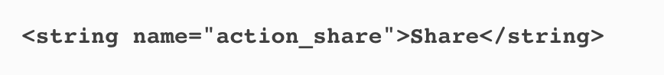
Notes:
Add a share action provider to menu_main.xml
You add a share action to the action bar by including it in the menu resource file.
To start, add a new action_share string to strings.xml. We’ll use it to add a title to the share action in case it appears in the overflow:

Slide 46
Notes:
You add the share action to the menu resource file using the <item> element as before. This time, however, you need to specify that you’re using a share action provider. You do this by adding an attribute ofandroid:actionProviderClass and setting it to android.widget.ShareActionProvider.
When you add a share action to your menu resource file, there’s no need to include an icon. The share action provider already defines one.
Now that we specify what content to share.

Slide 47
Notes:
Specify the content with an intent
To get the share action to share content when it’s clicked, you need to tell it what to share in your activity code. You do this by passing the share action provider an intent using its setShareIntent() method. Here’s how you’d get the share action to share some default text when it’s clicked:
You need to call the share action provider’s setShareIntent() method whenever the content you wish to share has changed. As an example, if you’re flicking through images in a photo app, you need to make sure you share the current photo.

Slide 49
Notes:
Test drive the app
When you run the app, the share action is displayed in the action bar. When you click on it, it gives you a list of apps to choose from that can accept the intent we want to share. When you choose an app, it shares the default text.

Slide 50
Notes:
EXTRA EXTRA CREDIT
Enabling Up navigation
If you have an app that contains a hierarchy of activities, you can enable the Up button on the action bar to navigate through the app using hierarchical relationships. As an example, MainActivity in our app includes an action item on its action bar that starts a second activity, OrderActivity. If we enable the Up button onOrderActivity’s action bar, the user will be able to return to MainActivity by clicking on it.

Slide 51
Notes:
Up navigation may sound the same as using the Back button, but it’s different. The Back button allows users to work their way back through the history of activities they’ve been to.
So that you can see this in action, we’re going to enable the Up button on OrderActivity’s action bar. When you click on it, it will display MainActivity.
Use the Back button to navigate back to the previous activity.
Use the Up button to navigate up the app’s hierarchy.

Slide 52
Notes:
The Up button, on the other hand, is purely based on the app’s hierarchical structure.

Slide 53
Notes:
Setting an activity’s parent
The Up button enables the user to navigate up a hierarchy of activities in the app. You declare this hierarchy inAndroidManifest.xml by specifying the parent of each activity. As an example, we want the user to be able to navigate from OrderActivity to MainActivity when they press the Up button, so this means thatMainActivity is the parent of OrderActivity
From API level 16, you specify the parent activity using the android:parentActivityName attribute. For older versions of Android, you need to include a <meta-data> element that includes the name of the parent activity. Here are both approaches in our AndroidManifest.xml:

Slide 54
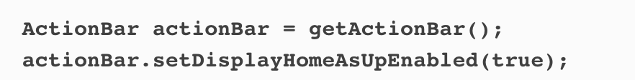
Notes:
Adding the Up button
You enable the Up button from within your activity code. You first get a reference to the action bar using the activity’s getActionBar() method. You then call the action bar’s setDisplayHomeAsUpEnabled()method, passing it a value of true.

Slide 55
Notes:
We want to enable the Up button in OrderActivity, so we’ll add the code to the onCreate() method in OrderActivity.java. Here’s our full activity code:

Slide 56
Notes:
Test drive the app
When you run your app and click on the Create Order action item, OrderActivity is displayed as before.
OrderActivity displays an Up button in its action bar. When you click on the Up button, it displays its hierarchical parent MainActivity.

Slide 57
Bullet Points
To add an action bar to apps supporting API level 11 or above apply one of the Holo or Material themes.
Add an action bar to apps supporting API level 7 or above by applying an AppCompat theme and using theActionBarActivity class. If you use ActionBarActivity, you must use an AppCompat theme.
ActionBarActivity and the AppCompat themes are in the v7 appcompat support library.
The android:theme attribute in AndroidManifest.xml specifies which theme to apply.
You define styles in a style resource file using the <style> element. The name attribute gives the style a name. The parent attribute specifies where the style should inherit its properties from.
The default folder for style resource files is app/src/main/res/values. Put a style resource file in theapp/src/main/res/values-v21 folder if you want it to be used on API level 21.
Add action items to your action bar by adding items to a menu resource file.

Slide 58
Bullet Points
Add the items in the menu resource file to the action bar by implementing the activity’sonCreateOptionsMenu() method.
Say what items should do when clicked by implementing the activity’s onOptionsItemSelected()method.
You can share content by adding the share action provider to your action bar. Add it by including it in your menu resource file. Call its setShareIntent() method to pass it an intent describing the content you wish to share.
Add an Up button to your action bar to navigate up the app’s hierarchy. Specify the hierarchy inAndroidManifest.xml. Use the ActionBar setDisplayHomeAsUpEnabled() method to enable the Up button.

Slide 59
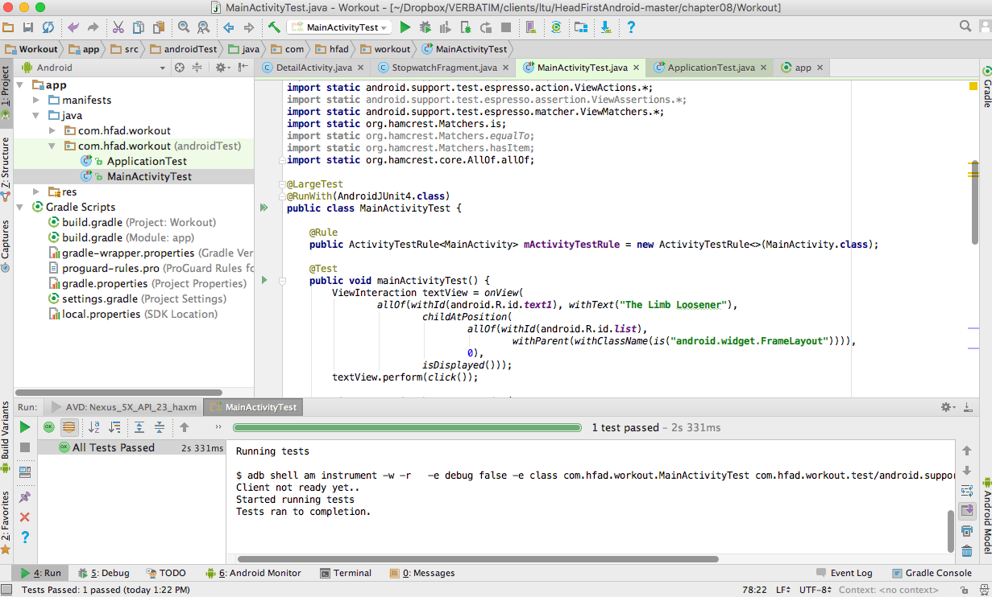
Notes:
Look at recording tests – show the workout example – Android 2.2

Slide 60
Thursday
Chap 10 - Navigation Drawers

